Slide 1

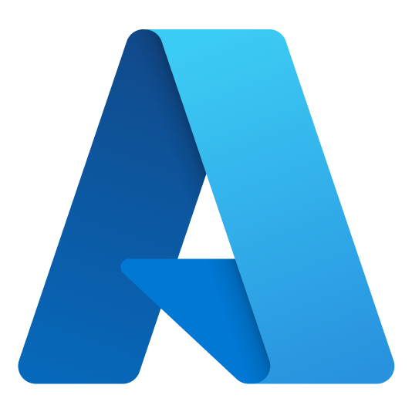
Azure Dev Day 2
Notes:
Welcome to Azure Dev Day

Slide 2




Adam Hems
Principal Cloud Solution Architect
Azure Dev Day
adamhems@microsoft.com
www.linkedin.com/in/adamhems
https://github.com/ahems
Notes:
Introduce yourself

Slide 3
Devs
Notes:
Today is all about YOU – developers
Even if you’re not a dev today should be helpful for you
3 target groups
Never used Azure – gain basic concepts
Familiar with Azure – understand common architectural patterns
Very knowledgeable – pick up some interesting nuggets

Slide 4
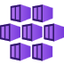
Day 2 Agenda (CDT)
6:30 | 3) Microservice solutions
7:30 | 4) DevOps for deploying solutions
8:30 | Closing thoughts
Notes:
4 content sections today
Each section has
An overview of the solution area
A hands-on lab
Lab is subset of solution area
We’ll also have
Breaks (including lunch)
Lots of FUN!
End around 3:30 Central today

Slide 5
Microservice Solutions
Develop and deploy microservices using Azure Kubernetes Service and Azure Container Registry

Slide 6

Overview of Containers

Slide 7

What is a Container?
Portable unit of deployment
Application code and dependencies compartmentalized
Virtualization without the need of a VM overhead
Best practice to organize one service/container
Physical Machine/VM
Container: Product:1.0
Container: Basket:2.0
Container: Product:2.0
Product.API v1
Basket.API v2
Product.API v2
Lib-L v2
Lib-L v3
Lib-L v3
Lib-M v2
Runtime v5
Runtime v7
Runtime v6
Notes:
Portable unit of deployment - Containers are a solution to the problem of how to get software to run reliably when moved from one computing environment to another. This could be from a developer's laptop to a test environment, from a staging environment into production and perhaps from a physical machine in a data center to a virtual machine in a private or public
Application code and dependencies compartmentalized - Simply put, a container consists of an entire runtime environment: an application, plus all its dependencies, libraries and other binaries, and configuration files needed to run it, bundled into one package. By containerizing the application platform and its dependencies, differences in OS distributions and underlying infrastructure are abstracted away.
Virtualization without the need of a VM overhead - With virtualization technology, the package that can be passed around is a virtual machine and it includes an entire operating system as well as the application. A physical server running three virtual machines would have a hypervisor and three separate operating systems running on top of it.
By contrast a server running three containerized applications as with Docker runs a single operating system, and each container shares the operating system kernel with the other containers.
Shared parts of the operating system are read only, while each container has its own mount (i.e., a way to access the container) for writing. Persistent Storage through Volume Mapping
A container may be only tens of megabytes in size, whereas a virtual machine with its own entire operating system may be several gigabytes in size.
Because of this, a single server can host far more containers than virtual machines. Virtual machines may take several minutes to boot up their operating systems and begin running the applications they host, containerized applications can be started almost instantly.
Best practice to organize one service/container
Different versions of software on different environments
Scale out an environment easily
SCALE AS A MONOLITH – today we scale as monolith’s.
DEPLOY WITH ALL THOSE DEPENDENCIES WHICH MAY VARY
Slide Source
https://azure.microsoft.com/en-us/documentation/articles/service-fabric-overview-microservices/
Notes
(1) A monolith app contains domain specific functionality and is normally divided by functional layers such as web, business and data.
(2) You scale monolithic apps by cloning it on multiple servers/VMs/containers.
(3) A microservice application separates functionality into separate smaller services.
(4) This approach scales out by deploying each service independently, creating instances of these services across servers/VMs/containers.
Designing with a microservice approach is not a panacea for all projects, however it does align closer with the business objectives described earlier. Also starting with a monolithic approach may be acceptable if you know that later you have the opportunity to rework the code into a microservice design if necessary. More common is that you have a monolith app today and you can slowly break this apart in stages starting with the functional areas that need to be more scalable or agile.
PUSH THE CONTAINER TO REMOTE MACHINE

Slide 8
What Problems Do Containers Solve?
Guarantees consistency across DEV, TEST and PROD
Increases Productivity
Isolation & Performance
Smaller footprint than VMs
Containers are a great environment for deploying Microservices
Notes:
Guarantees consistency across DEV, TEST and PROD
Provides portability – works across all environments
Increases Productivity
Dramatic reduction in Sprint 0 timelines
Isolation & Performance
Container instances are isolated between services and OS
Smaller footprint than VMs
Optimize density and consolidation
ility to design for very fast, very efficient scaling

Slide 9

Moving to Microservices

Slide 10
Moving to Microservices
Re-platforming a monolith to a microservice–based architecture
Product
Cart
Pricing
Client App
User Interface
P
C
P
Functional application areas decomposed into isolated service
Business Logic
P
C
P
Prod
Cart
Price
By definition, each microservice stores its own data
Data Access
P
C
P
Database
Relational
Doc
Name/
Value
Monolithic App
Notes:
On left - Traditional 3 tier or N tier architecture with horizontal layering.
Most of the great (micro services architecture) MSA examples migrated from this monolithic, horizontal design: Netflix, LinkedIn, Uber etc.
MSA is a Vertical (functional) slice of monolith. Each and every function becomes separate MS
One service represents one responsibility
Instead of having a single DB for entire app, each service has its own data store and can range from RDB, NoSQL or other
(This is called “Polyglot persistence” – best storage for each specific service)
As part of refactoring, each MS exposed as API – UI layer now becomes SPA or mobile that consume that API

Slide 11


Traditional application approach
Microservices application approach
A traditional application has most of its functionality within a few processes that are componentized with layers and libraries.
Scales by cloning the app on multiple servers/VMs
App 1
A microservice application segregates functionality into separate smaller services.
Scales out by deploying each service independently with multiple instances across servers/VMs
App 1
App 2
Independent deployment and scale of microservices
Coarse-grained density of apps/services
Fine-grained density of services
Need to deploy and scale the full application
Notes:
Deployment models of monolithic vs microservices
Instantiate Services instead of spinning up new machines => faster
Better utilization of hardware
Optimize Cost
Lower time to market: more confident when it comes to upgrading a service
Services are independently:
- Implemented
- Deployed
- Scaled
- Versioned

Slide 12
How Monoliths Diminish Agility
Single codebase - singe release pipeline
All teams share code base/dependencies – tightly-coupled
All team share same release cadence
A defect in a dependency can block multiple teams and the release itself
Dev team A
Dev team B
Release
Production
Dev team C
Dev team D
Notes:
Why do we need to move to MSA?
#1 reason: Unified single code base with a single release pipeline.
A bug found in one team can block other teams and the entire release process
If feature A breaks, the other teams who depend on feature A are blocked as is the release
The more development teams, the less manageable it becomes

Slide 13
How Microservices Promote Agility
Each team owns it own service and codebase…
Services are isolated and do not directly share dependencies
Each service has its own release cadence
Each deploys independently
Dev team A
Release
Production
Dev team B
Release
Production
Dev team C
Release
Production
Dev team D
Release
Production
Notes:
With MSA, each team owns its service and deploys it separately into separate production environment
As each service exposes API endpoints, it is isolated from the others.
So even if one of the services has a problem, it doesn’t directly affect other services.
Question here might be, “How much change each release should include?“
Netflix allows to deploy only one significant change at a time.

Slide 14

Kubernetes - Container Orchestrator

Slide 15
Challenges of a containerized world
As application development has moved towards a container-based approach, the need to orchestrate and manage the inter-connected resources becomes important
Load Balancing
Naming and Discovery
Logging and Monitoring
Debugging and Introspection
Networking
Notes:
“Container-centric infrastructure”
Additionally: configuration management, debugging/introspection, identity and authorization
First of all.. You can run containers w/o any further infrastructure. Docker, Images and Go..
But you’ll super quickly face issues – for example how to distribute containers in a cluster? Where to start my Containers? What happens when a container or a container host failed? How to I distribute requests across multiple instances of an application or service? How to measure and how to scale applications based on load?
Load Balancing
Distributing traffic across containers at scale
Naming and Discovery
How do containers or groups find one another?
Logging and Monitoring
Keeping track of what containers are doing
Debugging and Introspection
Getting inside running containers
Networking
Differentiating container networks from host networks at scale

Slide 16
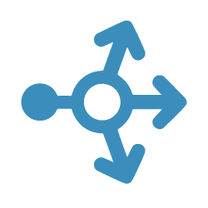
Application Scale
Web
Web
Web
Web
Web
API
API
API
Cache
Cache
Notes:
Here is a typical web environment <CLICK>
But we need to scale this <CLICK> <CLICK>
Add a load balancer <CLICK>
How would you configure an environment like this? Today you would need to configure a load balancer and add static ip addresses ext…..
This would not work in this environment where machines (containers) are constantly being moved around, added and deleted.
<CLICK>

Slide 17
Load Balancing & Fault Tolerance
NODE
Daemon
Containers
Image Cache
Web
Web
Web
Web
Web
Web
API
Cache
API
API
API
Cache
Cache
Notes:
Should all these containers be on a single host?? Probably not <CLICK>

Slide 18
The elements of orchestration
Scheduling
Affinity/anti-affinity
Health monitoring
Failover
Scaling
Networking
Service discovery
Coordinated app upgrades
Notes:
Hence, why we need an orchestrator:
Automates the deployment, management, scaling, networking, and availability of containers
Managers the lifecycle of containers in large environments
Allow users to guide container deployment and automate updates, health monitoring, and failover procedures

Slide 19
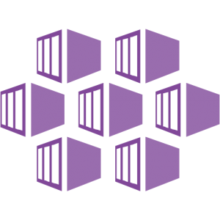

Container Orchestrators
Azure Kubernetes Service

Slide 20
Azure Kubernetes Service (AKS)
Fully-managed Kubernetes platform hosted in Azure as a PaaS service
Deeply integrated with Azure dev tools and services
Abstracts the complexity and operational overhead of managing Kubernetes
AKS implements K8s services, with a custom K8s config file optimized for Azure
AKS is a K8s managed service w/in Azure
At no charge…
Automated upgrades, patches
High reliability, availability
Automatic scaling
Self-healing
Monitoring

Slide 21


Control Plane
MASTER NODE
At no charge…
Automated upgrades, patches
High reliability, availability
Automatic cluster scaling
Self-healing
Monitoring
MASTER NODE
Daemon
Daemon
Containers
Image Cache
NO CHARGE
Containers
Image Cache
Container Scheduling
Container Orchestration
NODE
NODE
NODE
Daemon
Daemon
Daemon
Containers
Image Cache
Containers
Image Cache
Containers
Image Cache
Web
Web
Web
Web
Web
Web
API
Cache
Web
Web
API
Cache
API
Cache
API
Cache
API
Cache
API
Cache
Notes:
Azure Kubernetes Service is Kubernetes, optimized for Azure. The control plane is managed for you at no additional cost. You pay for the VM Nodes at your enterprise discount.
Azure Kubernetes Service (AKS) is a free container service that simplifies the deployment, management, and operations of Kubernetes as a fully managed Kubernetes container orchestrator service.
Paying for only the virtual machines, and associated storage and networking resources consumed makes AKS the most efficient and cost-effective container service on the market.

Slide 22
AKS Features
High Availability
High Reliability
Cluster Autoscaler
Security
Monitoring
Availability Zones
99.95% SLA
Self-Healing
Node Autoscaler
Virtual Nodes
Azure Key Vault
Azure Active Directory
Private Clusters
Azure Log analytics with Container Insights
Notes:
Availability Zones provide a higher level of availability to protect against a hardware failure or a planned maintenance event
Node Autoscaler - This ability to automatically scale up or down the number of nodes in your AKS cluster lets you run an efficient, cost-effective cluster. https://docs.microsoft.com/en-us/azure/aks/cluster-autoscaler
Virtual Nodes - To rapidly scale application workloads in an AKS cluster, you can use virtual nodes. With virtual nodes, you have quick provisioning of pods, and only pay per second for their execution time. Can handle overflow while nodes are being added to cluster.
Monitoring – a single analytics dashboard for all of Azure including Kubernetes. Can be used along with Promethius
https://docs.microsoft.com/en-us/azure/aks/monitor-aks

Slide 23
AKS – References
Documentation, learn, best practices, industry use cases

Slide 24

AKS References
Azure Kubernetes Service landing pages
Azure Kubernetes Service portal
Azure Kubernetes Service pricing
Azure Kubernetes Service documentation
Azure Kubernetes Service education
Azure Kubernetes Service learning path
Azure Kubernetes Service 50 days challenge
Azure Developer Cloud Skills Challenge

Slide 25
Container Orchestrators
Additional Container Options

Slide 26

Azure Container Apps
Run your container app on a serverless platform
Used to build Kubernetes style applications without access to native Kubernetes APIs
Dynamically scale based on
Http Traffic
Event-driven processing
CPU or memory load
Any KEDA-supported scaler
https://docs.microsoft.com/en-us/azure/container-apps/overview
Notes:
https://docs.microsoft.com/en-us/azure/container-apps/overview

Slide 27

Azure Arc-enabled Kubernetes
Attach Kubernetes clusters running anywhere (on-premises or other Cloud vendors)
Your cluster will show up in Azure Resource Manager
Your cluster will be placed in an Azure subscription and resource group
Your cluster will receive tags like any other Azure resource
https://docs.microsoft.com/en-us/azure/azure-arc/kubernetes/overview
Notes:
https://docs.microsoft.com/en-us/azure/azure-arc/kubernetes/overview

Slide 28
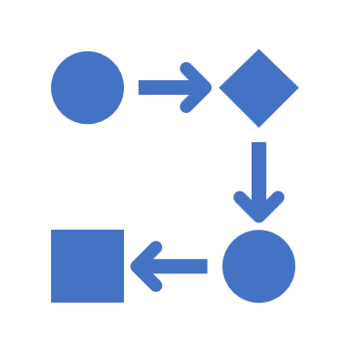

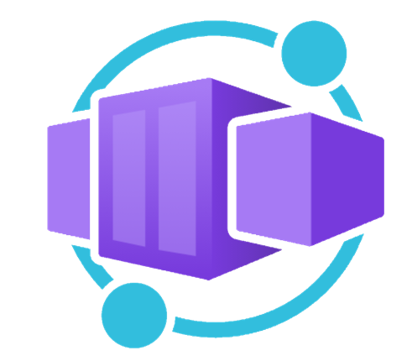




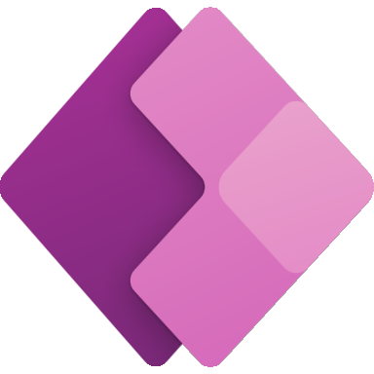
Application hosting continuum
IaaS
Infrastructure Platform
CaaS
Container Orchestration
Platform
PaaS
Application Platform
FaaS
Serverless Platform
Low Code
App and Orchestration
Platform
Virtual Machines
Azure Kubernetes
Service
Azure Container Apps
Azure Spring Apps
Azure App
Service
Azure Functions
Azure Logic
Apps
Power Apps
More Control of execution environment
Less Control of execution environment
Less Agile development & deployment
More Agile development & deployment

Slide 29
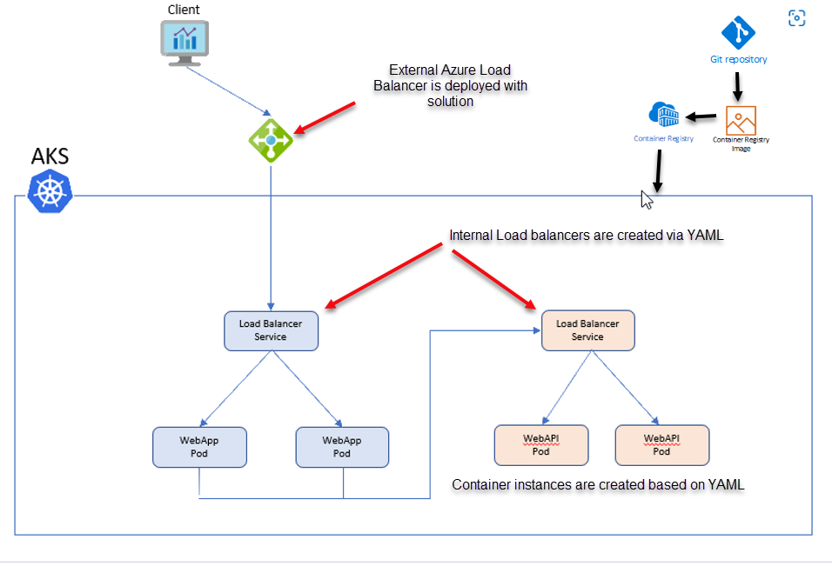
Microservice Solutions Lab
Deploy containers to AKS
aka.ms/azuredevdaylabs/microservices
Azure Dev Day
Notes:
https://aka.ms/azuredevdaylabs

Slide 30

Jim Blizzard
Cloud Solution Architect
Azure Dev Day
jim.blizzard@microsoft.com
https://www.linkedin.com/in/jimblizzard/
https://github.com/jimblizzard

Slide 31

DevOps with GitHub
Making the DevOps easier, faster, and more cost-effective with Azure and GitHub.
+
Notes:
“DevOps is the union of
people,
process, and
products to enable
continuous delivery of value to our end users.”

Slide 32
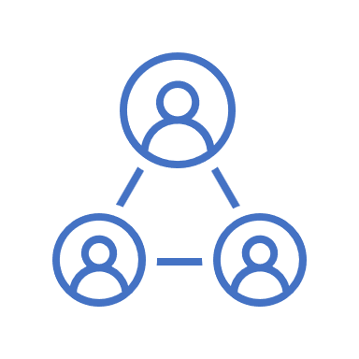
Azure
DevOps Phases
Plan
Develop
Collaborate
Deliver
Operate
Notes:
“DevOps is the union of people, process, and products to enable continuous delivery of value to our end users.”
Let’s talk about the different phases that make up DevOps and tools for each phase.
Plan & Track – GitHub Issues and Project planning
Develop -- Use whatever development environment you need
Collaborate -- you can Manage Source Code, Branches, Pull Requests, Issues, Discussions
Deliver -- you can use GitHub Actions to Build, Test, Package, Deploy to on prem or the cloud.
including INFRASTRUCTURE AS CODE.
Operate, Monitor & Learn -- Monitoring telemetry from your systems and these tools.
This all becomes a cycle. As we go from one phase to the next, we want to be learning and folding our learnings back into our next round of plans.

Slide 33

Why did Microsoft Acquire GitHub?

Slide 34
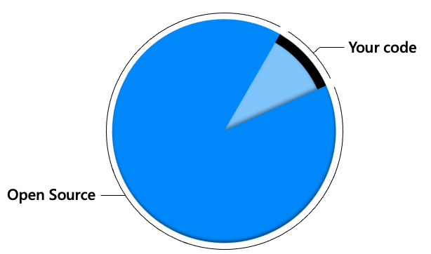

Modern enterprise applications
Notes:
In modern enterprise apps, 90% of the code comes from open source <click>
And <click> most of that lives in GitHub which has the world’s largest developer community

Slide 35
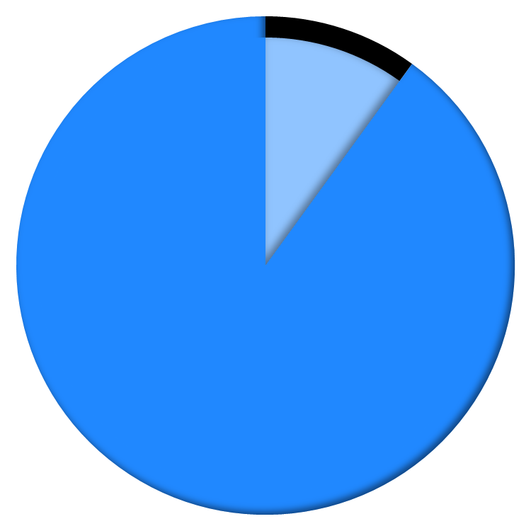


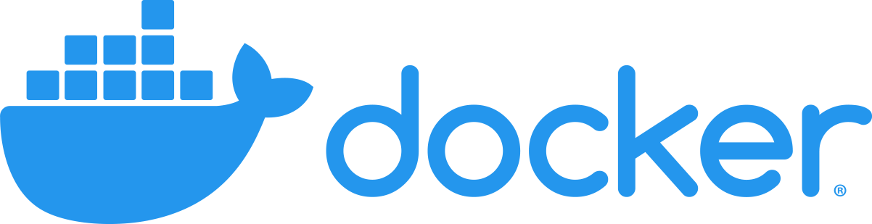

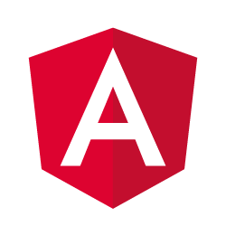
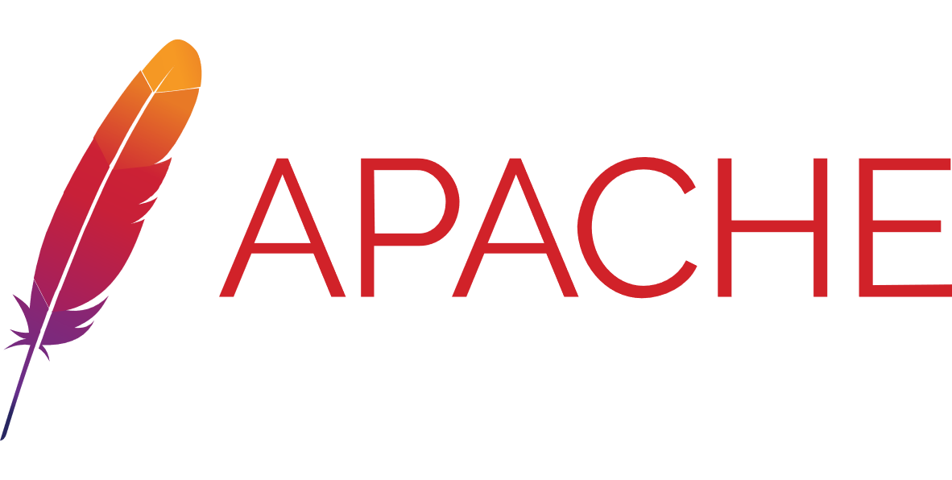


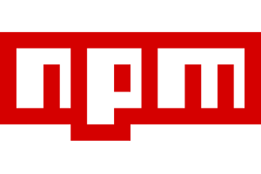
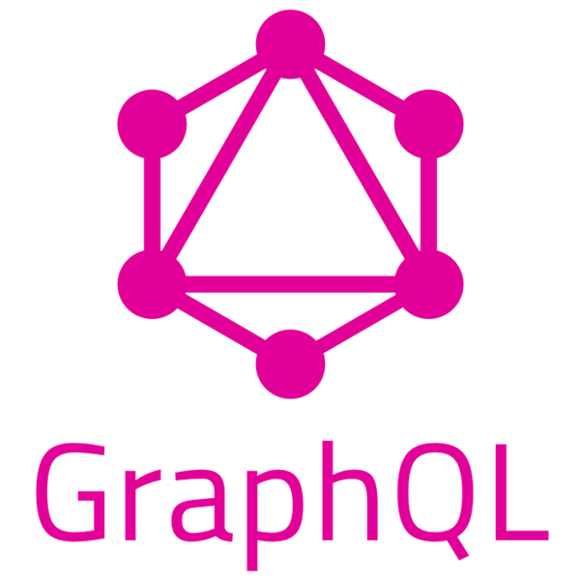
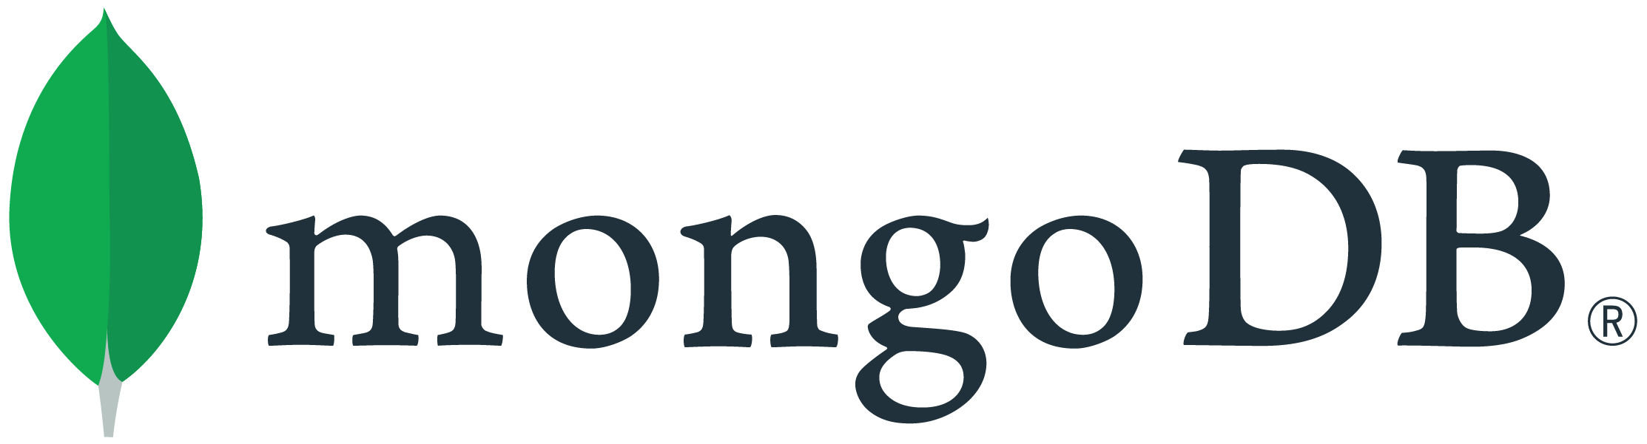

In modern enterprise applications 90% of the code comes from open source
Your code
Open Source
Most of that code lives on GitHub
Source: 2019 Synopsys Open Source Security report
Notes:
[Shanku] 90% of the code in new apps comes from open source. In fact, we find that on average projects have dependencies that rely on the works of more than 10 thousand developers And most of that code, and most of those developers, [CLICK] are on GitHub, and we help you collaborate with them.
And of course, even in your own organizations...

Slide 36


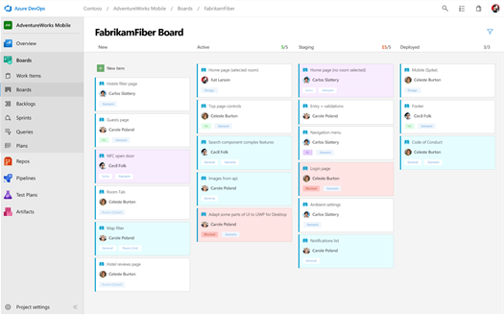
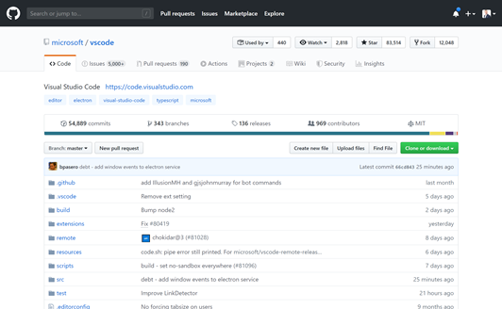
Microsoft is now committed to the world’s largest developer community
Azure DevOps
Empowering 1000s of enterprises
15+ years of developer innovation
GitHub
The home of open source software
65 million+ users
https://github.com/about
Notes:
We have Azure DevOps today, which has been incredibly successful. It empowers thousands of our customers with over 15 years of innovation focused on enterprises in particular, That’s been the sweet spot for us.
So, Why GitHub?
Microsoft’s Mission Statement is to “Empower every person and every organization on the planet to achieve more”
[click]
GitHub’s Vision is to be “The home for all developers” and GitHub has more than 65+ Million users
By making strategic investments in GitHub we will enable those 65+ million users to achieve more for their organizations by making GitHub the home for their DevOps tools.

Slide 37
Innersource with GitHub
Enabling open source culture and best practices inside your organization
Increased collaboration
Breaking silos
Higher developer satisfaction
Notes:
GitHub is just a better platform for Innersource. Azure Repos is just not as good at discovering and sharing code across teams like Windows, Office, etc.
Increased collaboration between teams
Break down walls between teams, allowing people with experience to contribute to projects across the company
And surveys have shown that this leads to increased developer satisfaction

Slide 38
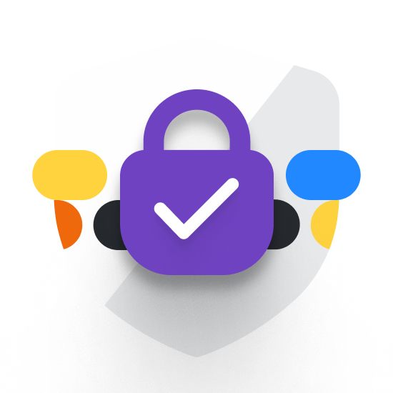


Secure the software lifecycle with GitHub
Dependency updates
Code scanning
Secret scanning
Included / GitHub Enterprise Cloud
GitHub Advanced Security (GHAS)
Notes:
With GitHub, we’re delivering a complete security offering.
We help you understand code dependencies, find vulnerable ones, and keep them up to date automatically, so you don’t end up with someone else’s vulnerable code.
Log4j vulnerability
With code scanning, we let you scan your own code, using CodeQL. CodeQL is used by many security research teams – including Google, Uber, and Microsoft – to keep some of the most used codebases in the world secure. And when you run code scanning, you’re querying your code for thousands of vulnerabilities – including the queries written by those security teams.
We scan your code for secrets, working with more than 20 providers to find passwords, keys, and other secrets, and take action.
NOTE: This is part of the GitHub Advanced Security (GHAS) SKU

Slide 39
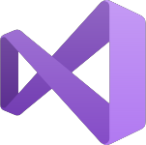


Azure
DevOps Phases
Plan
Develop
Collaborate
Deliver
Operate
Azure Boards
GitHub Issues
GitHub Discussions
Visual Studio
Visual Studio Code
GitHub Codespaces
Azure Repos
GitHub Repos
GitHub Adv. Security
GitHub for Mobile
Azure Pipelines
Azure Test Plans
Azure Artifacts
GitHub Actions
GitHub Packages
Azure DevOps Dashboards & Reporting
GitHub Insights
Azure Monitor
Security Center AKS Azure Functions
App Service
Event Grid
Notes:
(We want to break Azure DevOps and GitHub down into tools for each DevOps Phase. Otherwise customers tend to say “I can’t use GitHub because it doesn’t have everything I need (e.g. Sprint Planning, Manual Approvals in Actions Workflows, etc.). )
Rather than just talking about Azure DevOps and GitHub, let’s talk about the different phases that make up DevOps and tools for each phase.
Plan & Track – Laying out your Epics, Features, User Stories and Tasks. Also tracking bugs
Develop –Using tools like Visual Studio Code to edit your code.
Collaborate – Managing Source Code, Ensuring your code plays nicely with everyone else’s code via Pull Requests
Deliver
Build – Using Centralized Build systems
Test – Running automated and manual tests and tracking their results
Release – Packaging your solutions for release
Deploy – Deploying your solutions to the cloud or on-prem
Operate, Monitor & Learn –Monitoring telemetry from your systems and these tools.
This all becomes a cycle. As you go from 1 phase to the next we want to be learning and folding our learnings back into our next round of plans.

Slide 40
Key GitHub Features

Slide 41
Secure your complete software lifecycle with GitHub
Dependency updates
Identify vulnerable dependencies, and update them to secure versions automatically
Code scanning
Scan your code for vulnerabilities, powered by CodeQL, and the work of the security research community
Secret scanning
Prevent secrets from leaking into code, including automatic remediation with 35+ providers
Included w/ GitHub Enterprise
GitHub Advanced Security (GHAS)
Notes:
Presentation tip: To keep the security conversation at a high level just use this slide. To go into more detail use the following 5 slides.
With GitHub, we’re delivering a complete security offering.
We help you understand your dependencies, find vulnerable ones, and keep them up to date automatically, so you don’t end up with someone else’s vulnerable code.
With code scanning, we let you scan your own code, using CodeQL. CodeQL is used by many security research teams – including Google, Uber, and Microsoft – to keep some of the most used codebases in the world secure. And when you run code scanning, you’re querying your code for thousands of vulnerabilities – including the queries written by those security teams.
We scan your code for secrets, working with more than 20 providers to find passwords, keys, and other secrets, and take action.
Martin, how about a demo?

Slide 42
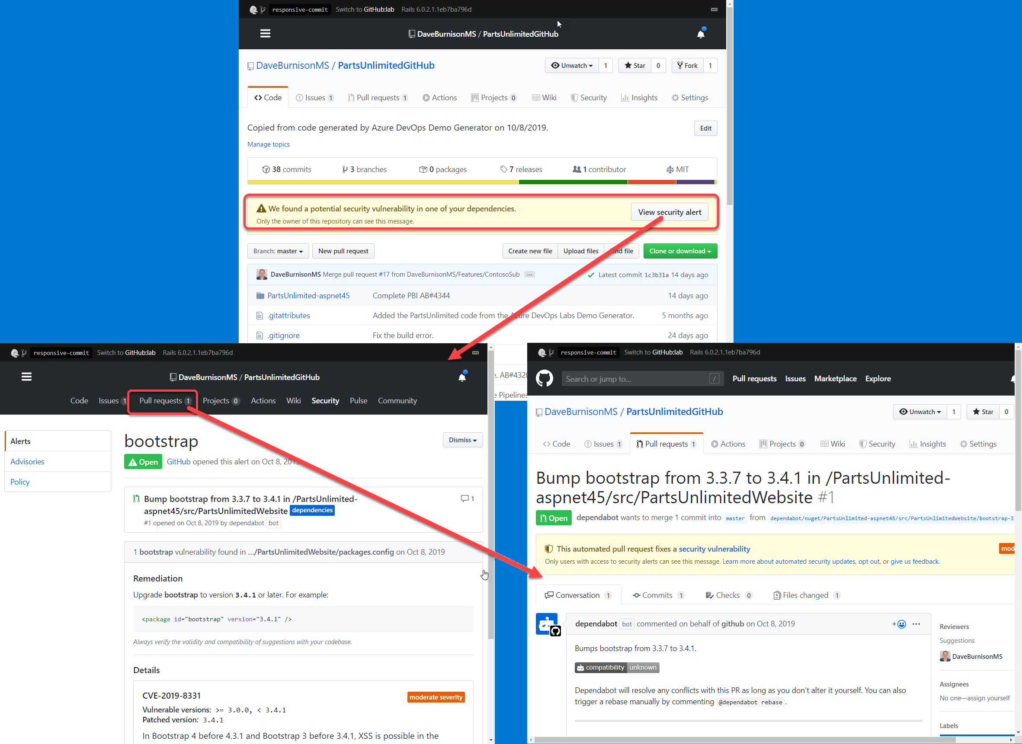
Dependency Scanning & Auto Security Updates - GitHub
Securing the software supply chain
Dependency graph
See the packages your project depends on, the repositories that depend on them, and any vulnerabilities detected in their dependencies.
Dependabot alerts
Get notified when there are new vulnerabilities affecting your repositories. GitHub detects and alerts users to vulnerable dependencies in public and private repos.
Dependabot security and version updates
Keep your supply chain secure and up-to-date by automatically opening pull requests that update vulnerable or out-of-date dependencies.
https://github.com/features/security
MICROSOFT CONFIDENTIAL – SHARED UNDER NDA
Notes:
NOTE: This is included with core GitHub.
Presenter Tip: After the animations build out, zoom in on the screenshots in the graphic 1 by 1 and walk through
The surfacing of the vulnerability
The details of the Dependabot alert including the CVE details.
The automatic creation of the PR by Dependabot
Acronyms
SAST = static application security testing
DAST – Dynamic application security testing
IAST – passive and active integrated security testing
RASP – runtime application security protection
SCA – fuzzy software composition analysis
This helps to automatically protect 100% of the code that you are deploying not just the 10% - 20% that your team is writing.
This automatically checks for known vulnerabilities as soon as you push code to GitHub, you do not have to add steps to your pipeline to do this. AND, when it finds a known vulnerability it automatically creates a Pull Request if it can find a resolution to the known vulnerability.
Rich vulnerability data: GitHub tracks vulnerabilities in packages from supported package managers using data from security researchers, maintainers, and the National Vulnerability Database— including release notes, changelog entries, and commit details. All discoverable in the GitHub Advisory Database.
We’ve sent over 62 million security vulnerability alerts across GitHub. Industry data shows that 70% of vulnerabilities remain unpatched after 30 days. Many take a year or more! The reason for this is because it’s just too hard today to find and apply patches with confidence. Think back to what that led to with Equifax. They could have patched known Struts vulnerability well before the well-publicized breach. Because we know how difficult it can be to resolve these alerts, we took a big step to helping make that easier with automated security updates. Now GitHub creates automated updates for known vulnerabilities that allow you to quickly merge and deploy remediating changes to your codebase.

Slide 43

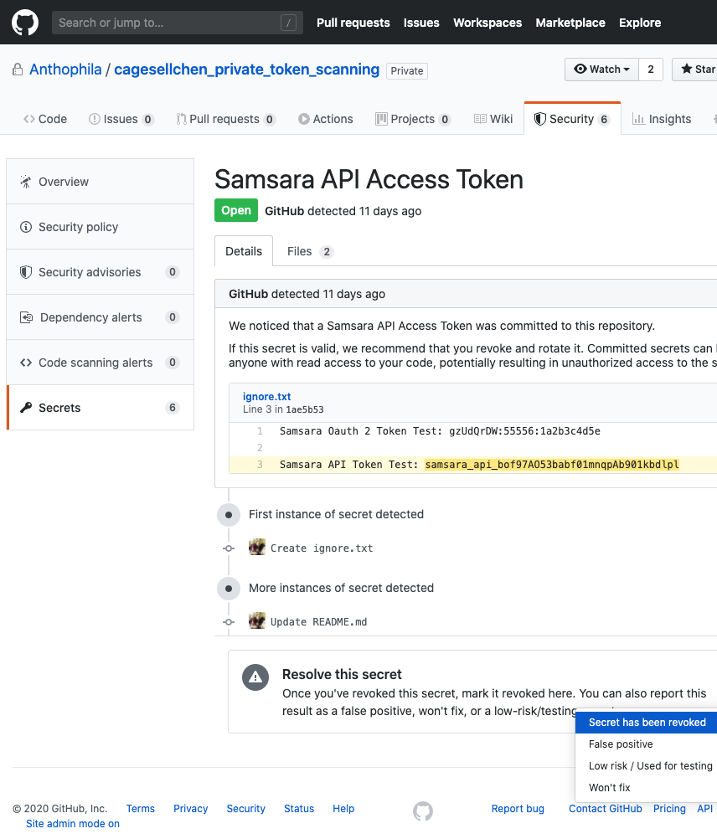
Secret Scanning - GitHub Keeping your secrets, a secret
Identifies secrets as early as possible
Finds secrets the moment they are pushed to GitHub and immediately notifies developers when they are found. Scan your entire git history.
Community of secret scanning partners
For every commit made to your repository, and its full git history, we'll look for secret formats from secret scanning partners
Supports both public and private repos
Secret scanning watches both public and private repos for potential secret vulnerabilities.
Protection from exposed secrets
Automatically disable or suspend secrets from 35+ service providers as soon as they are committed.
https://github.com/features/security
Notes:
NOTE: This is part of the GitHub Advanced Security (GHAS) SKU
Acronyms
SAST = static application security testing
DAST – Dynamic application security testing
IAST – passive and active integrated security testing
RASP – runtime application security protection
SCA – fuzzy software composition analysis
We’re now expanding our coverage to include private repositories for secret scanning. Our capabilities include finding secrets the moment they’re pushed to GitHub, scanning git history and user controls for excluding false positives.
We’re currently supporting more than 25 major service providers including Google Cloud, AWS, Azure, Alibaba Cloud and others. This feature is now available in limited public beta for GitHub Enterprise Cloud.

Slide 44
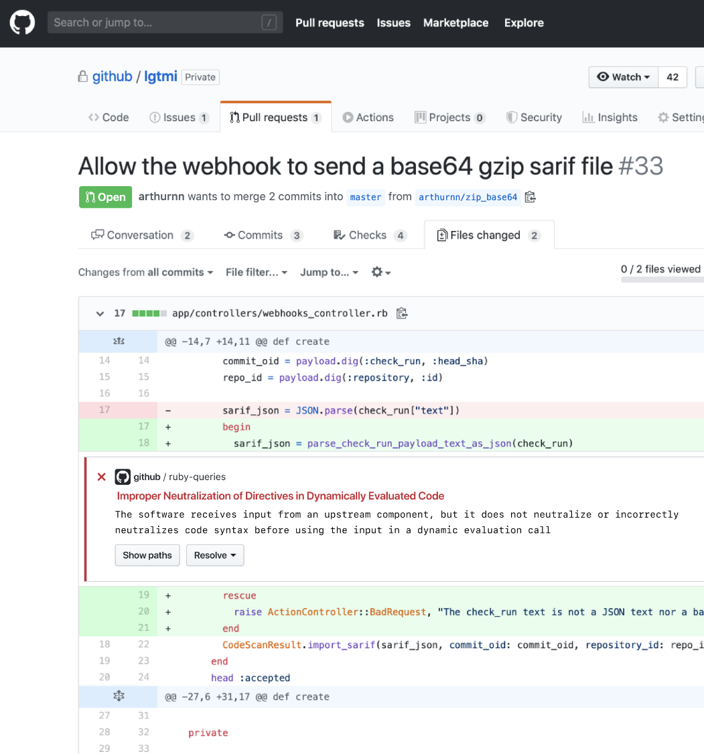
Code Scanning - GitHub Preventing vulnerabilities from the start
Find and fix vulnerabilities fast
Find and fix vulnerabilities before they are merged into the code base with automated CodeQL scans.
Community of top security experts
Community-driven query set powers every project with a world-class security team. Or, create your own custom queries.
Integrated with developer workflow
Integrate security results directly into the developer workflow for a frictionless experience and faster development.
Extensible
Plug other SAST tools into the same developer workflow.
Notes:
NOTE: This is part of the GitHub Advanced Security (GHAS) SKU
Acronyms
SAST = static application security testing
DAST – Dynamic application security testing
IAST – passive and active integrated security testing
RASP – runtime application security protection
SCA – fuzzy software composition analysis
Automated code scanning will provide native security scanning capabilities to the developer workflows.
With these capabilities, our customers will be able to secure code as it’s being developed. New security issues are automatically flagged directly in the pull request where they can be immediately fixed. Security issues are prioritized so that developers can fix the most urgent matters first. Developers and security teams can collaborate on the GitHub platform to triage and fix the issues efficiently.

Slide 45
Code Scanning - Community of top security experts
Code Scanning - Community of top security experts - GitHub Shared security expertise empowers any software organization immediately
Fast and easy to write with extensive libraries. Based on vulnerabilities discovered internally. Often given back to the community where relevant.
Outd
Custom
Community-powered
Created by a vast community of leading security researchers at Microsoft, Google, Uber and others. Regular additions for new classes of vulnerabilities.
Security & Vulnerabilities
CWEs
OWASP Top 10
SANS 25
Language best practices
Correctness
Non-attributable
Readability
Reliability
Statistical
Efficiency
Maintainability
Thousands of analyses created by GitHub’s team of security researchers and language experts, in collaboration with GitHub’s customers.
GitHub-powered
Notes:
2000+ queries out of the box:
You can get value out of the box (clarify this point strongly)
And then you can decide what to do from there
Acronyms
SAST = static application security testing
DAST – Dynamic application security testing
IAST – passive and active integrated security testing
RASP – runtime application security protection
SCA – fuzzy software composition analysis

Slide 46
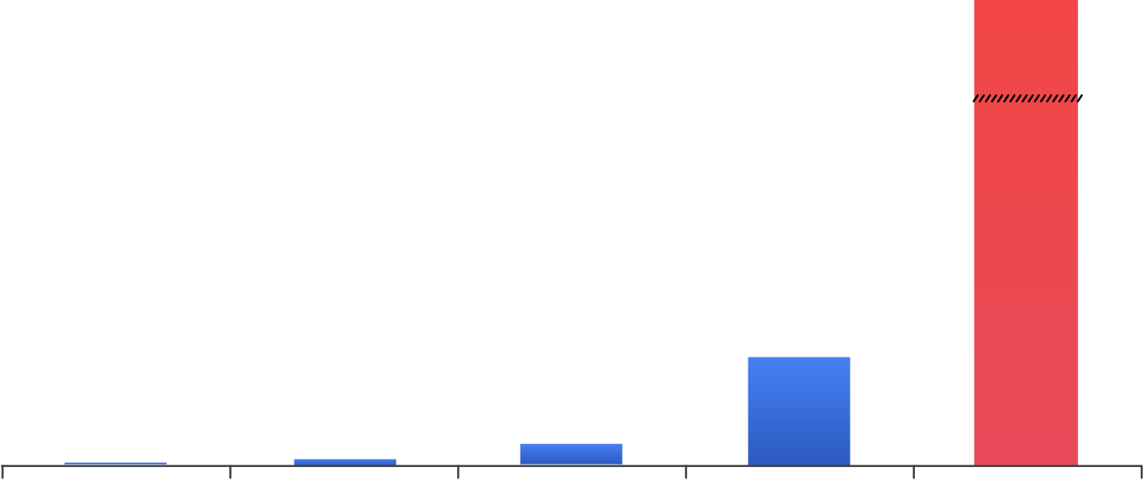
Shift security left
Application flaws: #1 attack vector for breaches
Remediate during development
Lifecycle
Stages
Develop
Build
Test
Deploy
Breach
$ Millions
$7,600
$80
$240
$960
Remediation
Costs
Development
Build
Test/QA
Production
Breach
Sources: NIST, Polemon Institute, Verizon Data Breach Investigations reports 2016, 2017, 2018, 2019 and 2020.
Notes:
A security breach can be tremendously costly
And trying to harden applications after they’re written can be very difficult.
The solution is to shift security development left, addressing security concerns early in the development process. Developers work to fix vulnerabilities when they are found, but they also continue to introduce vulnerabilities into their code bases. So how do we shift security left?
<click>
So for both the code you write and the Open Source code used in your applications
Our aim is to make these security checks a key part of the developer workflow allowing you to identify security issues as soon as possible. Thus, reducing the time, effort and costs associated with keeping your applications secure.

Slide 47
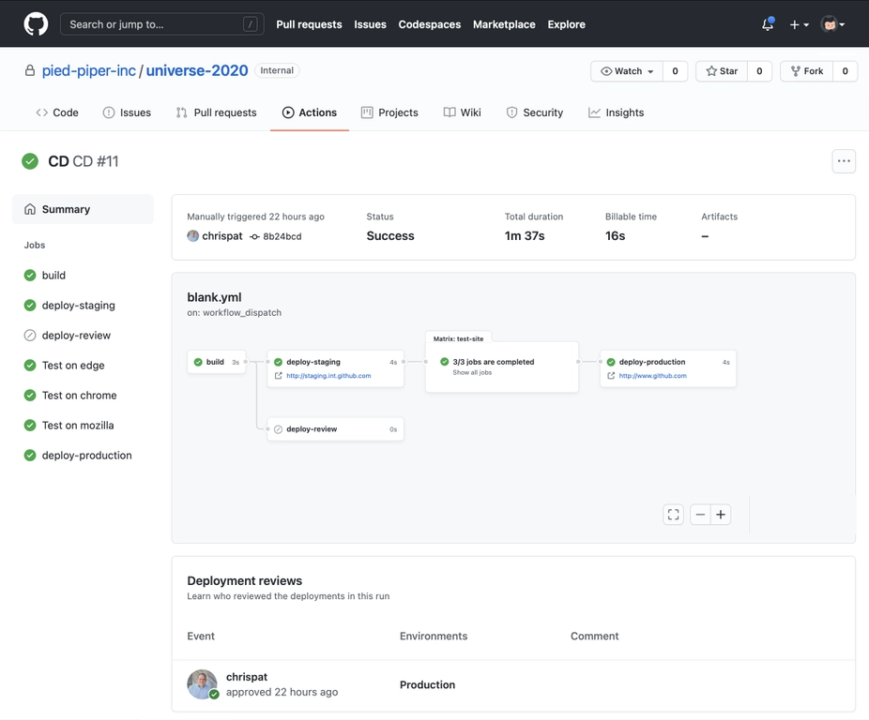
GitHub Automation
Automating workflows from code to cloud
https://github.com/features/actions & New from Universe 2020: Environments, Manual Approvals and Workflow Visualization
Notes:
You can automate a lot more than just CI/CD
https://docs.microsoft.com/en-us/azure/developer/github/
Talking points:
Pull Request automation
Create Issues on the fly based on keywords
Community-powered workflows, more actions than other CI/CD tools

Slide 48
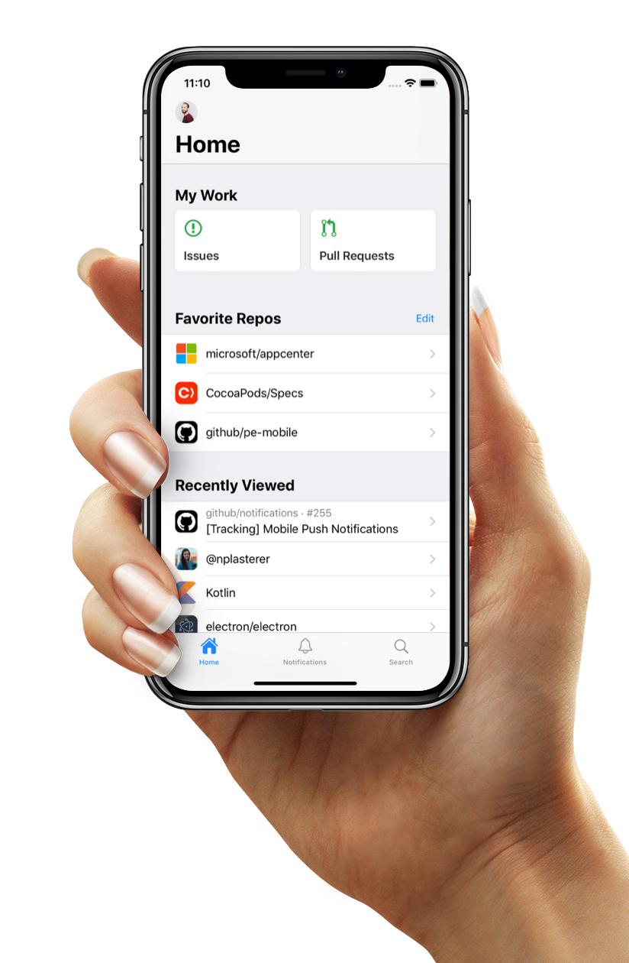
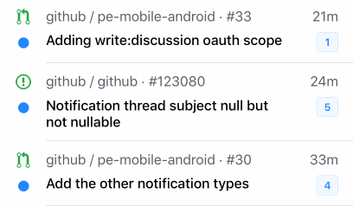
GitHub Mobile
Collaborate and develop, on-the-go
Stay connected
Stay in touch with your team and the GitHub Community, right from your mobile device
Collaborate from anywhere
Collaborate on Issues and Pull Requests with a totally redesigned experience. Comment, react, and merge code.
Breeze through your workflow
Get your inbox to zero in no time—swipe to finish a task or save the notification to return to it later.
https://github.com/mobile/
Notes:
Quickly access your issues and pull requests dashboard on the go.
Ensure secure access by leveraging multi-factor authentication
Search GitHub for Users, Repos, Orgs, Issues, and Pull Requests. Browse results with mobile-optimized designs.
Collaborate on Issues and Pull Requests with a totally redesigned experience. Comment, react, and merge code.
“Favorite Repos” and “Recently Viewed” sections
With GitHub mobile, you can:
Organize tasks in a swipe: Get your inbox to zero in no time—swipe to finish a task or save the notification to return to it later.
Give feedback and respond to issues: Respond to comments while you’re on the go.
Review and merge pull requests: Merge and mark pull requests to breeze through your workflow, wherever you are.

Slide 49
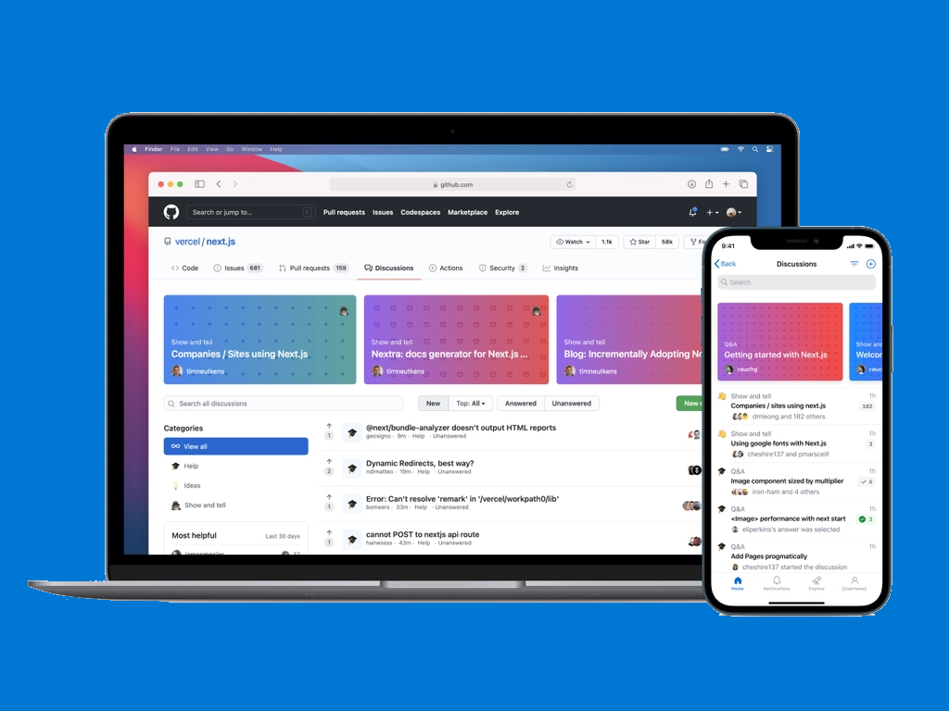
Discussions
Join the conversation
Open conversations about code and community
New threaded format makes it easy to brainstorm feature ideas, help new users get their bearings, and collaborate on software.
Perfect for Q&A
Questions can be marked as answered, so over time a community’s knowledge base grows naturally
Familiar GitHub experience
Discussions live in your project repository, so they’re accessible where your community is already working together.
https://docs.github.com/en/discussions
Notes:
Software communities don’t just write code together. They brainstorm feature ideas, help new users get their bearings, and collaborate on best ways to use the software. Until now, GitHub only offered issues and pull requests as places to have these conversations. But issues and pull requests both have a linear format—well suited for merging code, but not for creating a community knowledge base. Conversations need their own place—that’s what GitHub Discussions is for.
Discussions live in your project repository, so they’re accessible where your community is already working together. Their threaded format makes it easy to start, respond to, and organize unstructured conversations. Questions can be marked as answered, so over time a community’s knowledge base grows naturally. And because discussions aren’t closed the way issues are, they can easily serve as a place for maintaining FAQs and other collaborative documentation. We recognize that community discussion is as much a part of development as coding, so discussion contributions appear in users’ contribution graphs.
Talking points:
New/Requested Features Discussions
Issues with a particular feature

Slide 50
Preview features

Slide 51
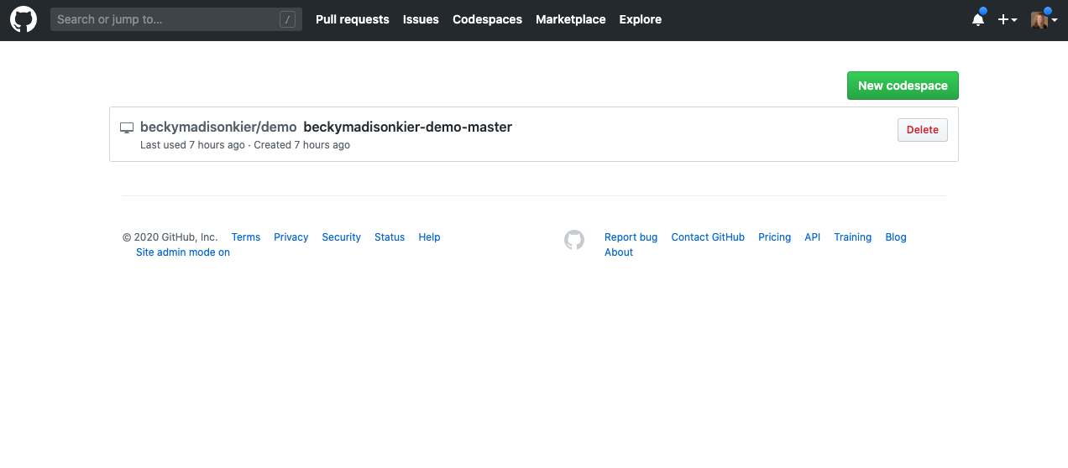
GitHub Codespaces
Your instant dev environment
https://github.com/Features/Codespaces
Notes:
Reducing time to set up development environments from hours to seconds
Powered by web-based version of VS Code, or use with your desktop IDE
Fully integrated into the GitHub developer experience
Talking points
Code on Any device
Instant Productivity

Slide 52
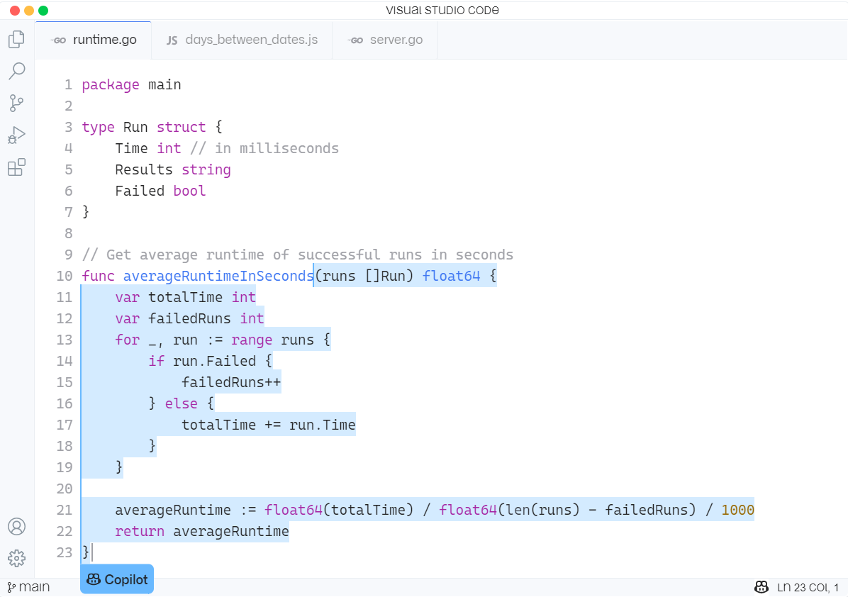
GitHub Copilot
Your AI pair programmer
Introducing GitHub Copilot: your AI pair programmer
Notes:
With GitHub Copilot, get suggestions for whole lines or entire functions right inside your editor.
Trained on billions of lines of public code, GitHub Copilot puts the knowledge you need at your fingertips, saving you time and helping you stay focused.
GitHub Copilot is powered by Codex, the new AI system created by OpenAI (gpt3). GitHub Copilot understands significantly more context than most code assistants.
As developers, we know that everything has been written before, right?
Talking points:
---------------
Not Just Intelli-sense or auto complete.
Great for repetitive tasks like unit tests, unfamiliar territories like new languages or writing code that has been written before within the same context (Language/scope)

Slide 53
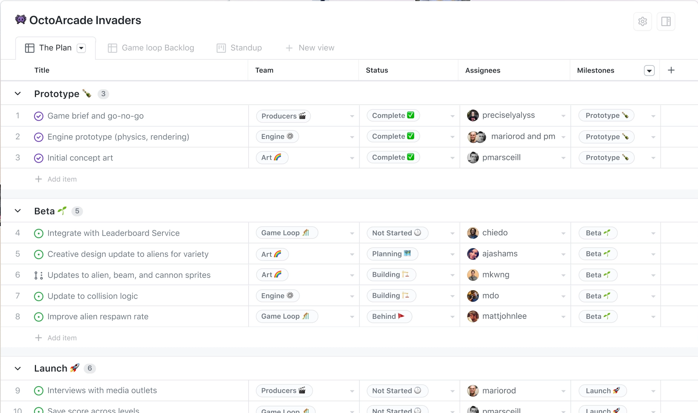
Planning
Introducing the new GitHub Projects
Introducing the new GitHub Issues | The GitHub Blog
Notes:
Talking points:
Better Project management capabilities with project tables -- more than just kanban style boards
Break issues into actionable tasks: Tackle complex issues with task lists and track their status with new progress indicators. Convert tasks into their own issues and navigate your work hierarchy.
Custom Views: build multiple tabs with custom filters, groups …
Extend issues with custom fields: Track metadata like priority, story points, dates, notes, and links. Add custom fields to project tables and edit from the issue sidebar.
Issues, wherever you look: Issues can be viewed, created, and managed in your browser, your favorite terminal, or on your phone or iPad.

Slide 54
What Does this Mean for Azure DevOps?
Microsoft is fully committed to Azure DevOps
Strategic investments in GitHub
Our commitments to you
Integration between GitHub Enterprise and Azure DevOps services
Integration between GitHub and Azure
Make it easier to acquire both products together
Comprehensive set of tools to move to GitHub
Notes:
Azure DevOps is NOT Dead
We are not deprecating or sunsetting Azure DevOps.
Remain fully committed to Azure DevOps customers. We will continue to support and invest in Azure DevOps in the long term. We will prioritize the needs of enterprise customers with a focus on scale, security, compliance, administration, and GitHub integrations.

Slide 55
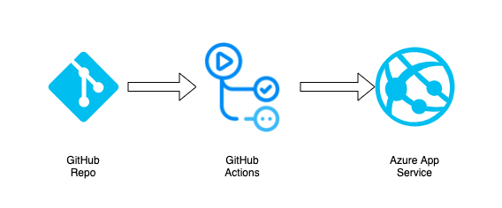
Lab time

Slide 56


DevOps Lab
GitHub Repo
GitHub Actions
Azure App Service
aka.ms/azuredevdaylabs/devops
Azure Dev Day

Slide 57

Choose the Best Tool for each Phase of DevOps
Notes:
What about today? What tools we should use today?

Slide 58

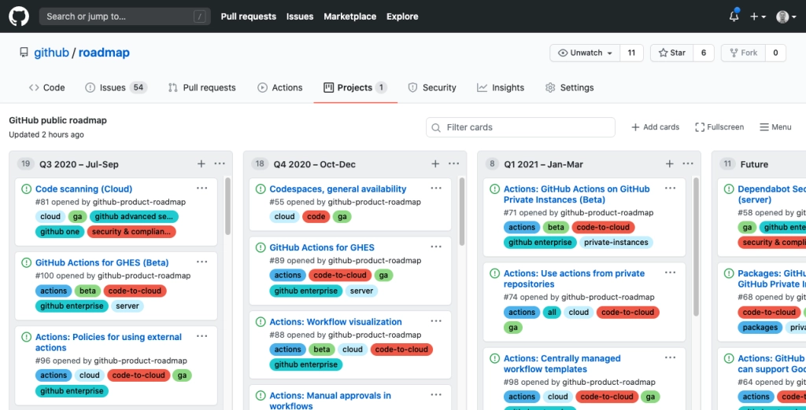
GitHub Public Roadmap
https://github.com/github/roadmap/projects/1
Give your team more information about what features and functionality you can expect from GitHub over the coming quarters.
With more transparency into what we’re building, you can also plan better.

Slide 59
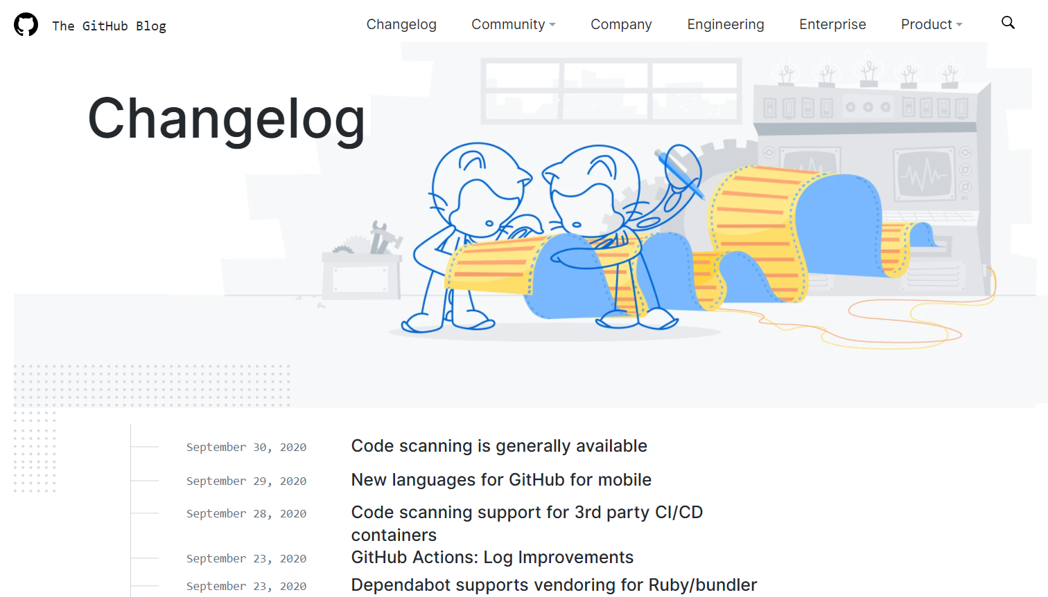
GitHub Changelog
https://github.blog/changelog & https://github.blog/tag/changelog-recap
Track the release of new features. These are the GitHub “Release Notes”.
Go to https://github.blog/ and click on “Changelog”.
Filter the blog posts by items tagged with “changelog recap” to see a monthly Changelog recap
Notes:
Series of blog posts with a monthly recap

Slide 60
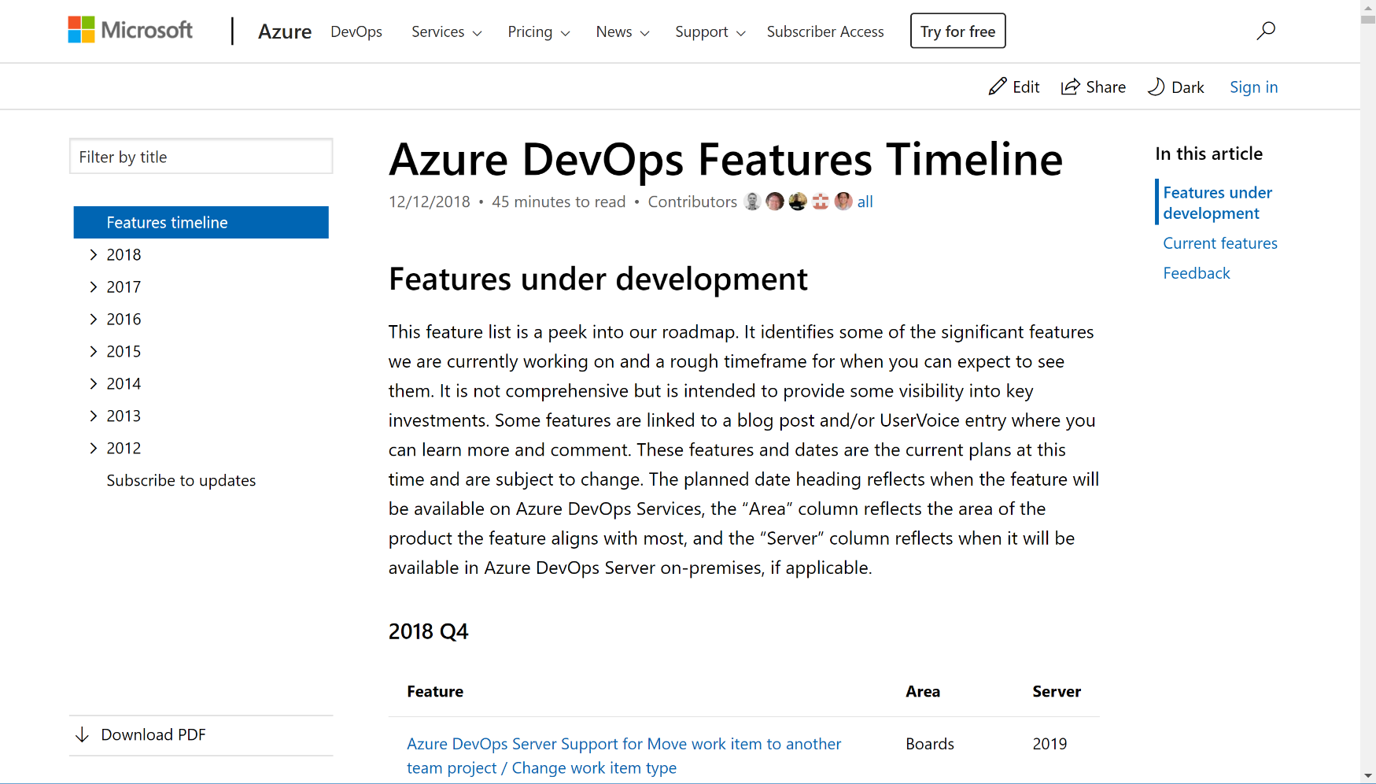
Azure DevOps Features Timeline
https://docs.microsoft.com/en-us/azure/devops/release-notes/features-timeline
Take a peek into our roadmap. See the significant features we are working on and a rough timeframe for when you can expect to see them
We deploy updates frequently. Review the release notes for each three week sprint
Subscribe to this page to get notified when we provide new release notes and roadmap updates

Slide 61
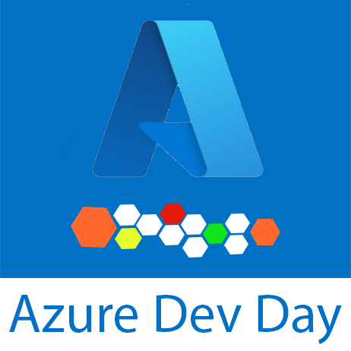
GitHub Lab
Deploy using GitHub Actions
GitHub (Actions)
App Service
https://aka.ms/azuredevdaylabs

Slide 62
Remember to clean up your resource groups!
Each of the labs explains the best way to clean up the resources that were created so you are not charged for them. Please be sure to complete those clean up tasks.
https://aka.ms/azuredevdaylabs

Slide 63
Next Steps
Reach out to your Microsoft team
Additional training courses
Architectural design sessions
Microsoft Learn
Azure Architecture Center
Azure Open Hack
Azure Dev Day

